Slide 1




Student Testimony as Curriculum:
Strengthening Community-Connected Instruction Through Lead & Learn
May 28, 2026 | CSxFE 2026
Notes:
3:45 Sonya

Slide 2
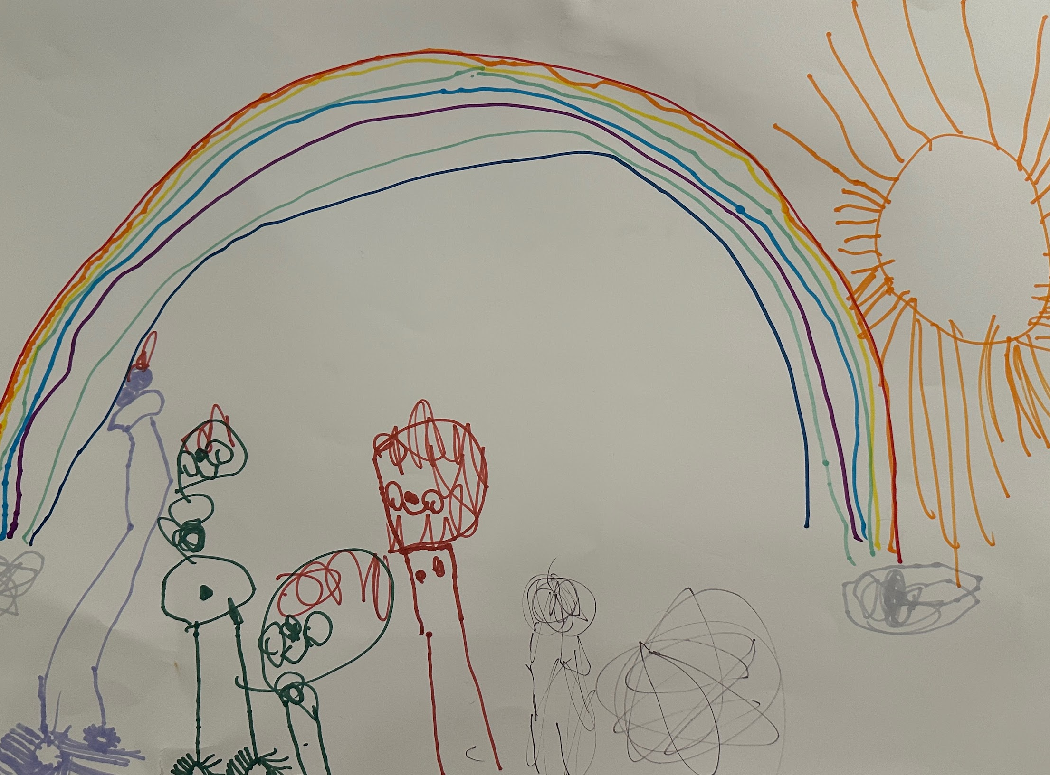
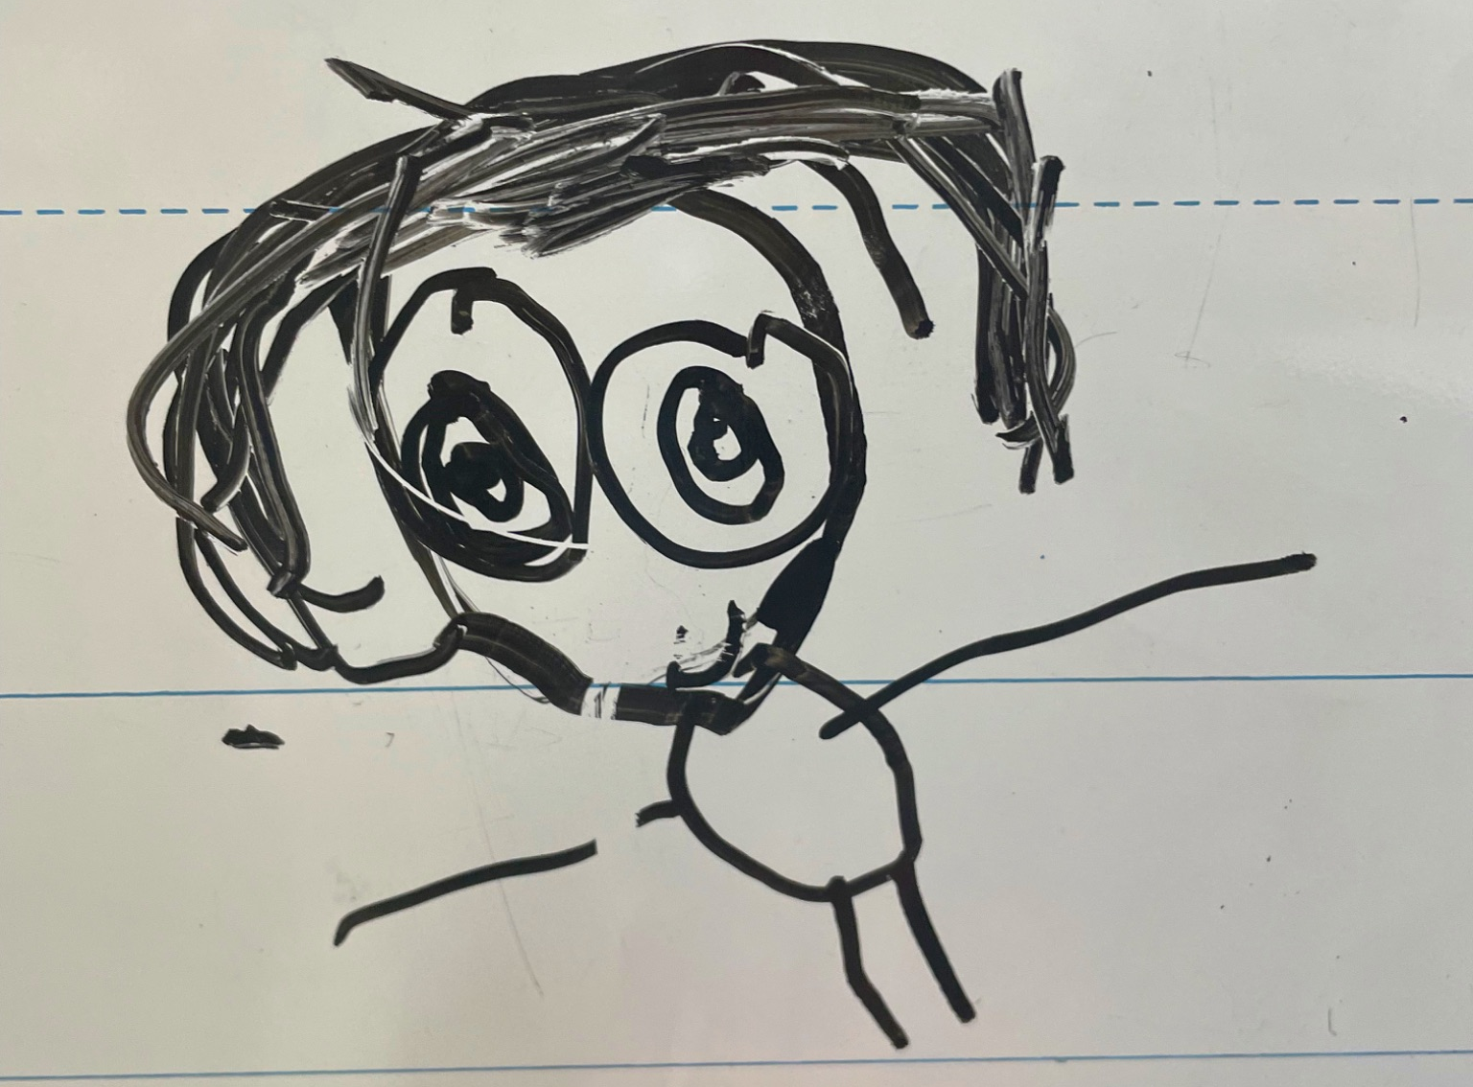
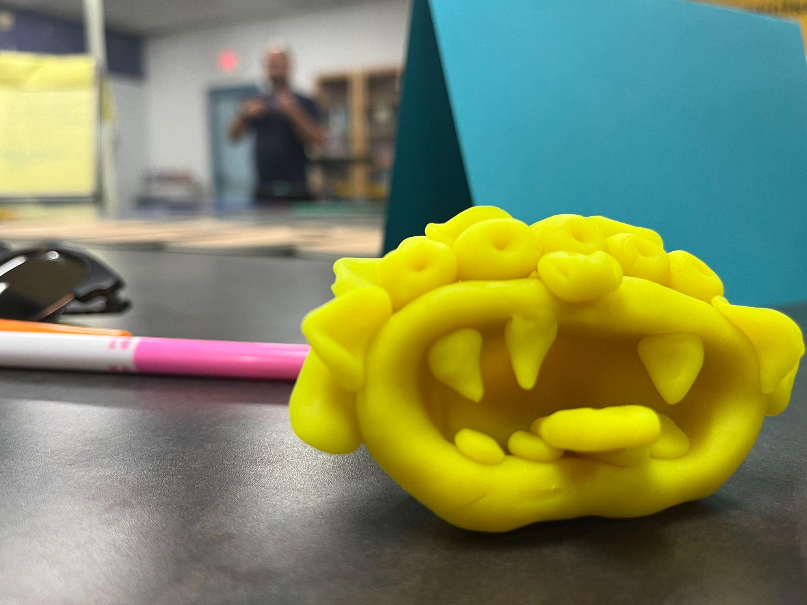
Who We Are
Robert Donovan
Albuquerque Public Schools
Sonya Romero-Autrey
Albuquerque Public Schools | Albuquerque Teacher Federation
Lindsay Wilwol
ABC Community School Partnership

Slide 3
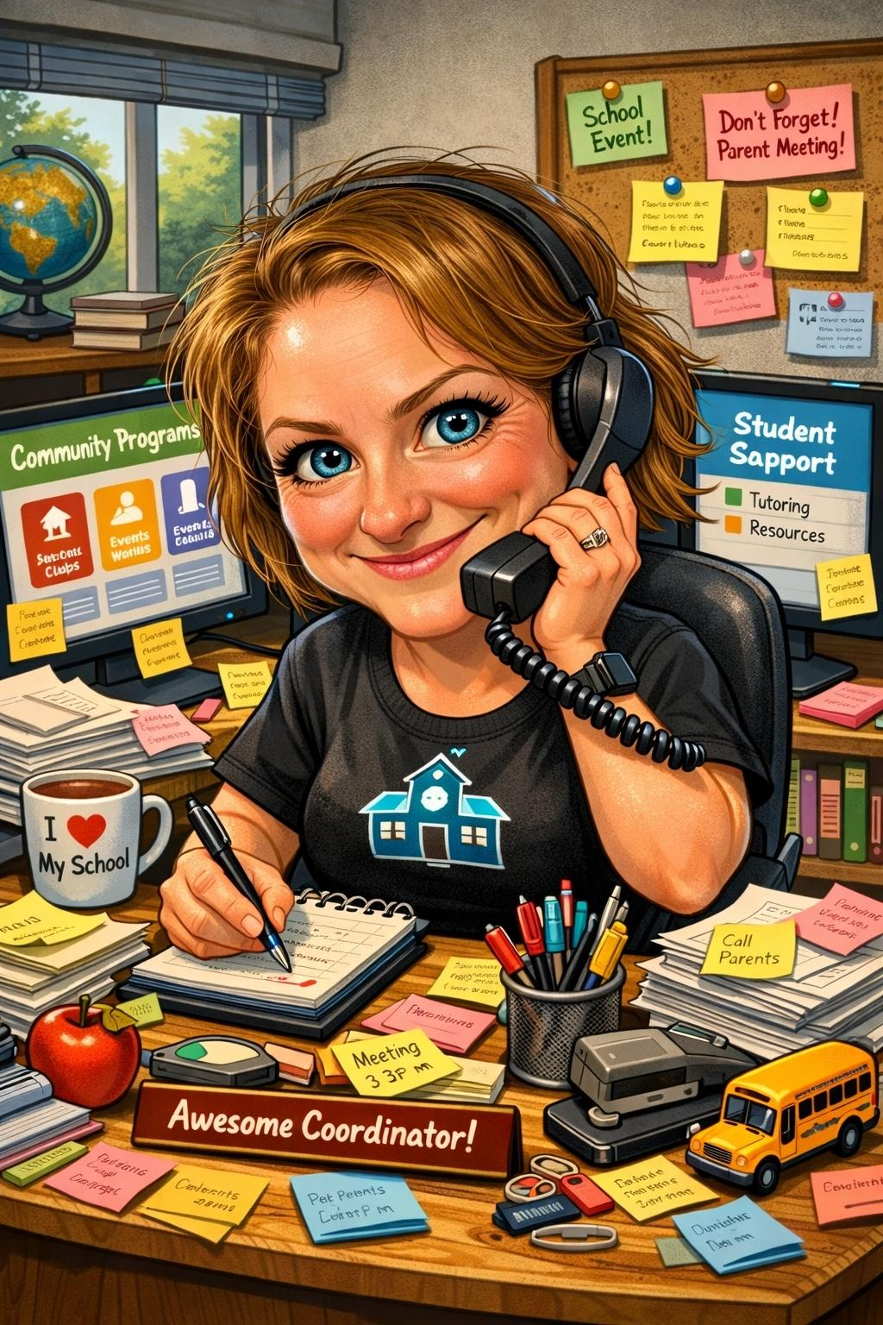
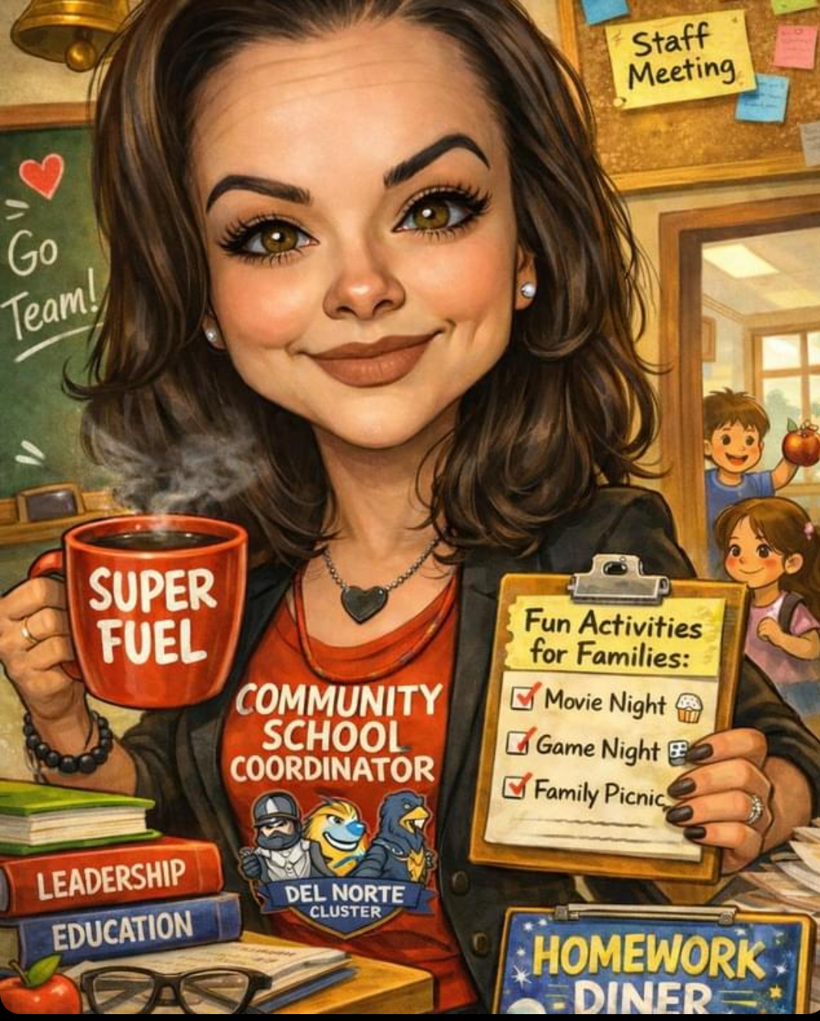
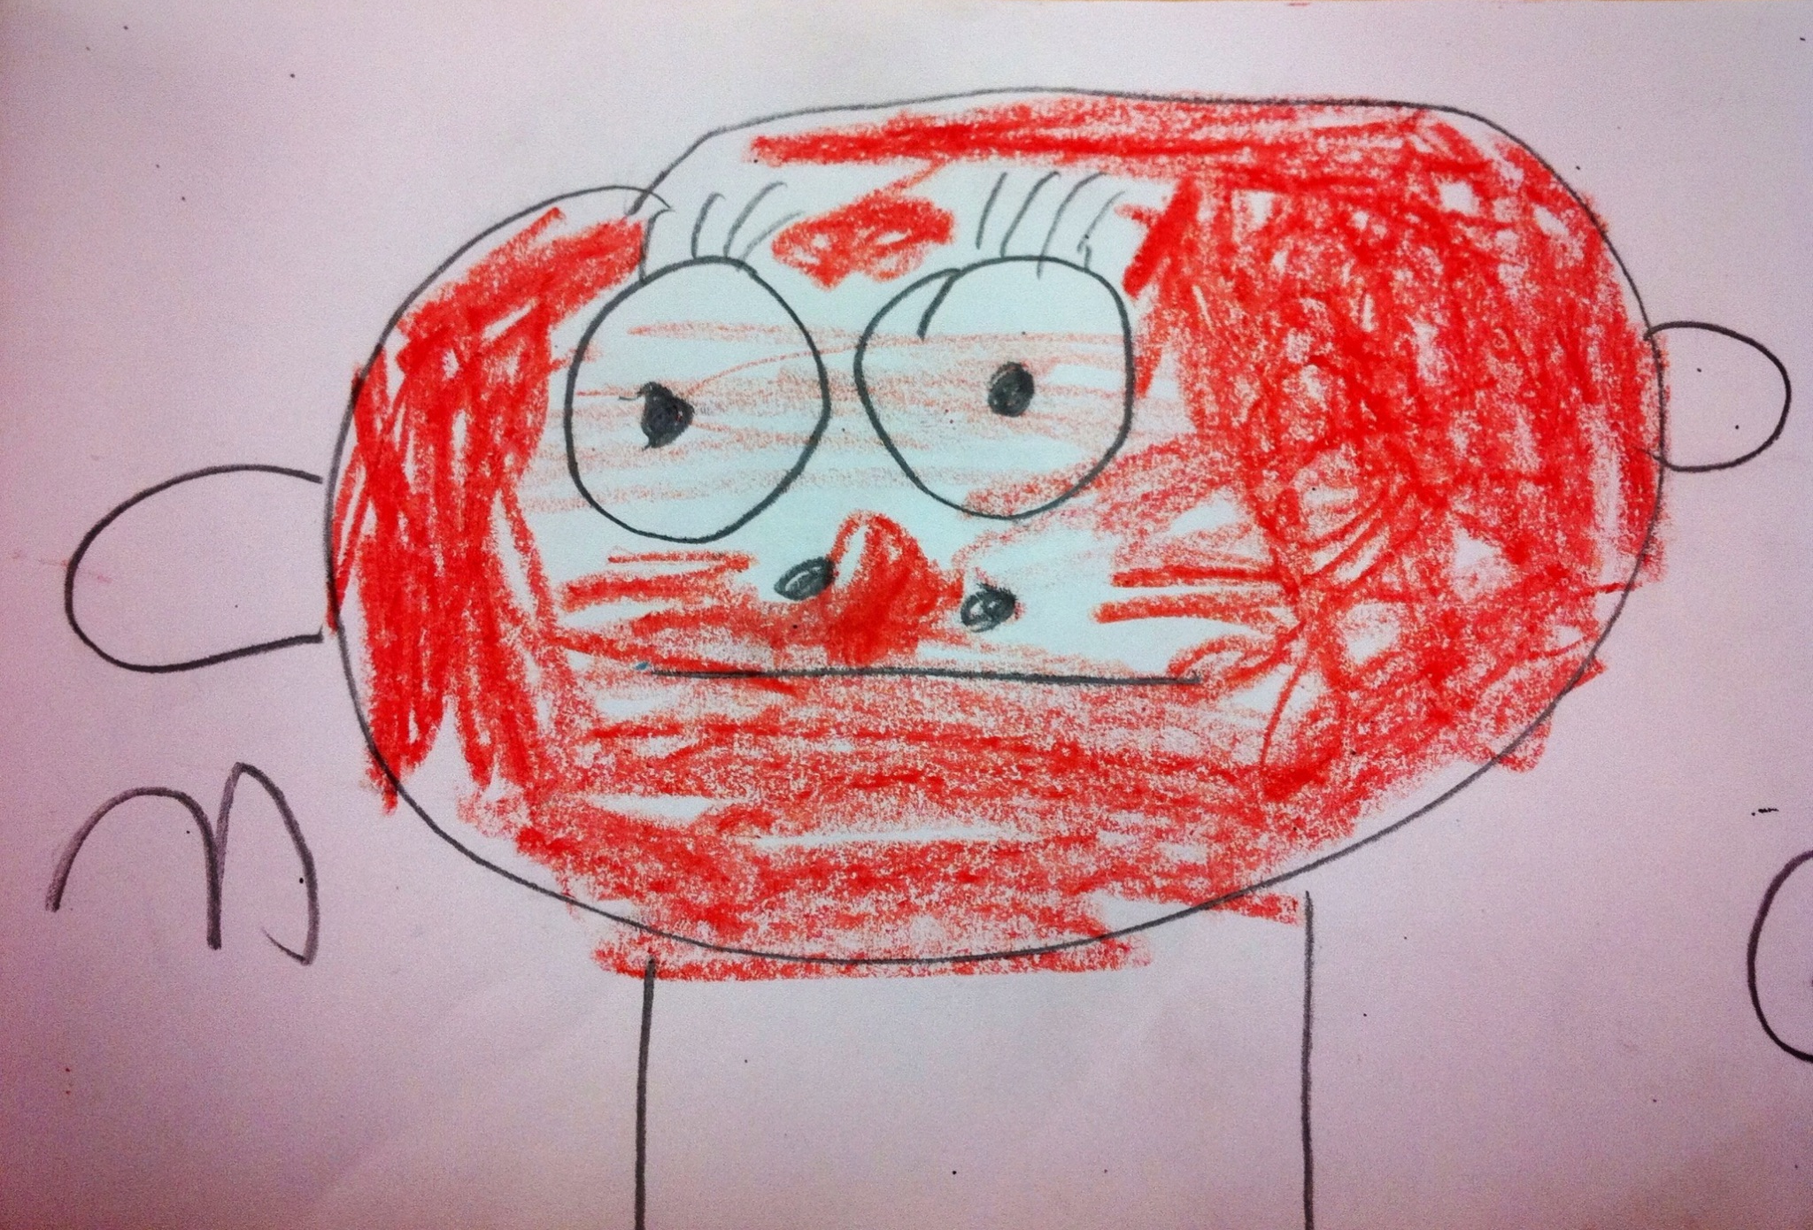
Who We Are
Catherine Wolfe Bornhorst
Born Ingenuity
Halecia Wimpy
Albuquerque Public Schools
Elizabeth Gomez
Albuquerque Public Schools

Slide 4
Who You Are
Educator
Coordinator
Principal
District Leader
Community Partner
Researcher/Evaluator
Family Coordinator/Liaison
Who did we miss?
Notes:
3:53 -Sonya

Slide 5
Think about a moment when a student changed how you understood teaching, learning, or school.
Turn & Talk
Briefly introduce yourself (Role, School/Organization).
What happened?
Why did it stay with you?

Slide 6
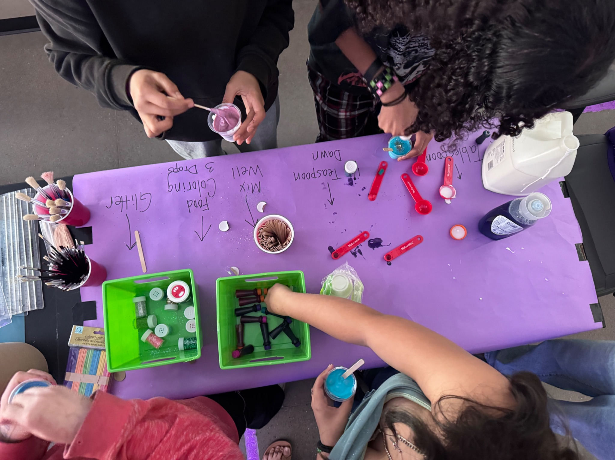
Agenda
Introductions & Opening Activity
Context: What is Lead and Learn?
Instruction as the lived experience of community schools
Student testimony as curriculum
Shared Leadership Responsibilities
What we learned through Lead & Learn

Slide 7
Session Overview
What is Lead & Learn?
Instruction as the lived experience of community schools
Student testimony as curriculum
Shared Leadership Responsibilities
What we learned through Lead & Learn
Notes:
4:03-Sonya

Slide 8
What is Lead & Learn?
Notes:
4:04 Robert

Slide 9
What is Lead and Learn?
Professional learning experience community school educators (and coordinators!) in the ABC Community School Partnership Network.
Focus on supporting educators in strengthening their student-centered, community connected instruction within the community school strategy
Created space (community of practice) for educators to examine how students experience belonging, rigor, identity and purpose through their instruction
Sessions engaged educators in reflection, dialogue, inquiry, and project design
Four cohorts since 2024 with over 70 educators in 40 schools
Two culminating public showcases

Slide 10
What is Lead and Learn?
Connect the community school strategy to daily classroom instruction
Center student testimony, lived experience, and voice as sources for curriculum
Strengthen rigorous, community-connected learning and instruction
Reflect on educator identity, purpose, well-being, and leadership
Build shared language across teachers, coordinators, principals, and district leaders
Develop instructional practices that are sustained by relationships, collaboration, and schoolwide conditions

Slide 11
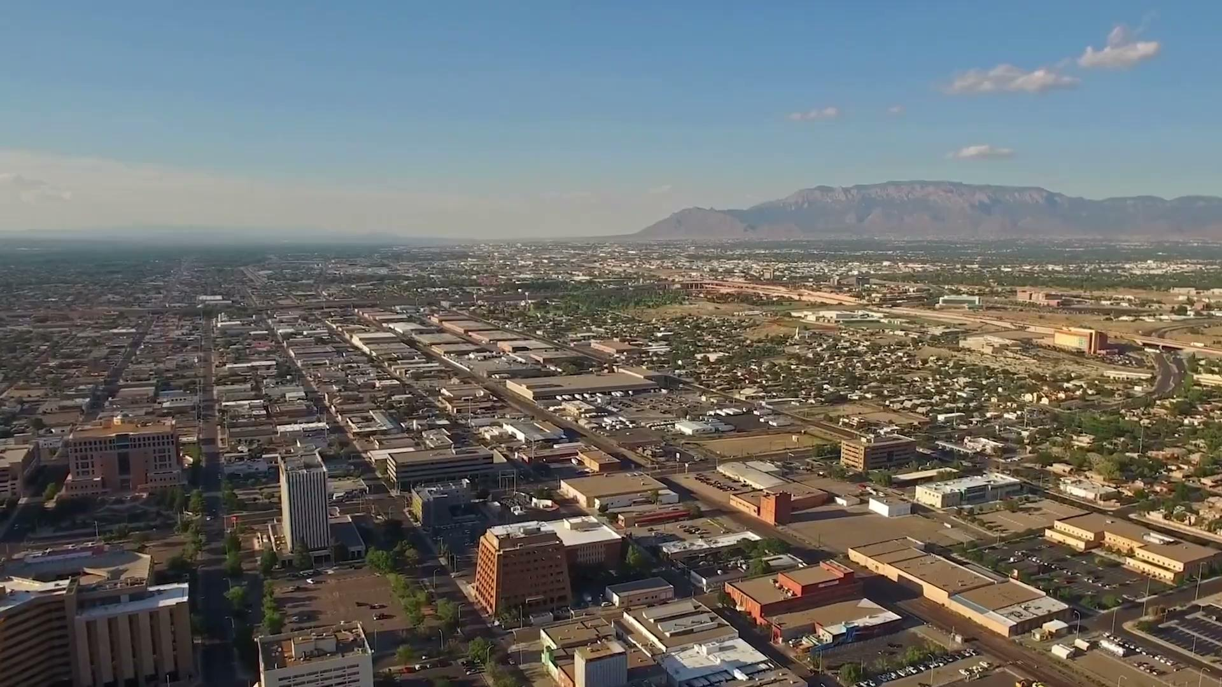

Slide 12
Instruction as the lived experience of community schools
Notes:
4:12 Catherine

Slide 13
How Community Schools are Experienced
It is through relationships with educators that students often experience and understand what a community school is. While community school strategies operate across systems and partnerships, instruction is the daily site where belonging, care, and rigor are enacted or undermined.
Notes:
Be sure to indicate who is considered an educator

Slide 14
How Community Schools are Experienced
Instruction communicates the values of the community school strategy to students and families
Strengthening community schools requires simultaneous attention to instructional practice, teacher efficacy, school connectedness, and educator well-being
Notes:
IRIS
Coordinator examples:Catherine
A family engagement effort that helped teachers better understand students and families
A student support issue that was affecting classroom experience
A partner or resource that made a learning experience possible
A schoolwide issue surfaced through council or collaborative leadership that affected instruction

Slide 15
What Sits Around Instruction?
Conditions out of the classroom shape what is happening inside the classroom.
Family Trust
Student supports
Relation-
ships
Student Experience Through Instruction
Teacher Well-
Being
Comm-
unity Partners
Time and Collaboration
School Culture
Notes:
Catherine and Halecia
This needs more - maybe include a handout with conditions or things we are talking about and seeing:
Catherine
Relationships
Family trust
Student supports
Community partnerships
Staff alignment
School culture
Teacher well-being
Leadership protection
Time and collaboration
Coordinators could add:
How they have help with connecting families, students, and staff
Encouraging asset-based mindsets about students, families, and community in the various areas they are in/lead
Connecting teachers to resources when non-academic needs surface
We share examples
These example are in service of the activities they will engage in later in the session - take note of what resonates
Three examples of this and how it works - can combine with slide 14 or diagram (we share our examples with the visual in mind)
IRIS

Slide 16
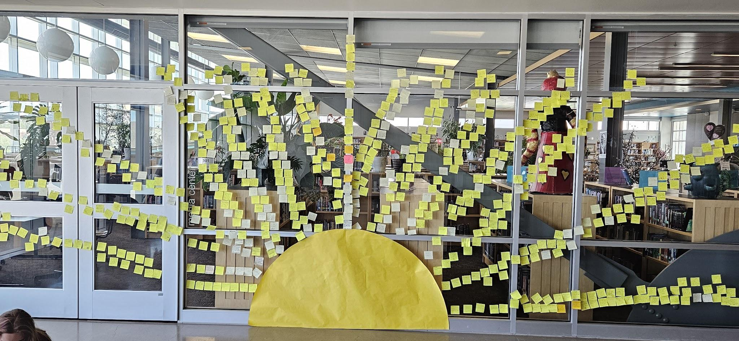
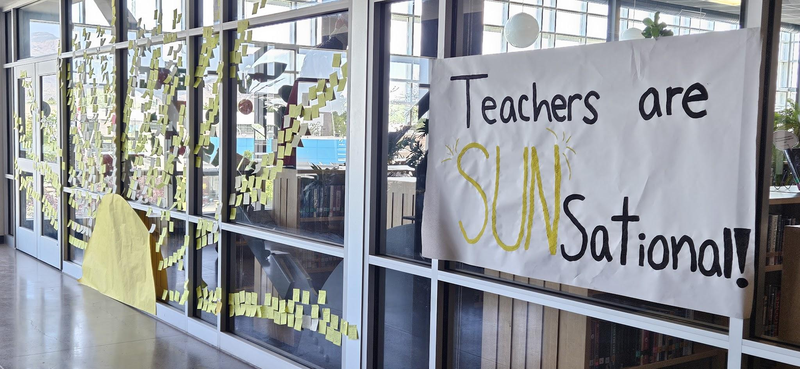
Our Staff are “Sun”sational!

Slide 17
Student Testimony as Curriculum & Shared Leadership
Notes:
4:20 Catherine

Slide 18
What Our Students Say, Do, Show, and Create Matters
Student testimony includes the everyday ways students reveal their experiences, questions, identities, relationships, challenges, strengths, and hopes.
Student testimony becomes curriculum when we as educators:
notice it
critically witness it (Dutro, 2009)
resist deficit interpretations
connect it to meaningful learning
respond instructionally

Slide 19
What Counts as Student Testimony?

Slide 20
What are students saying, doing, or showing, and what does it reveal about their experiences?
Notes:
Whole Group Conversation

Slide 21
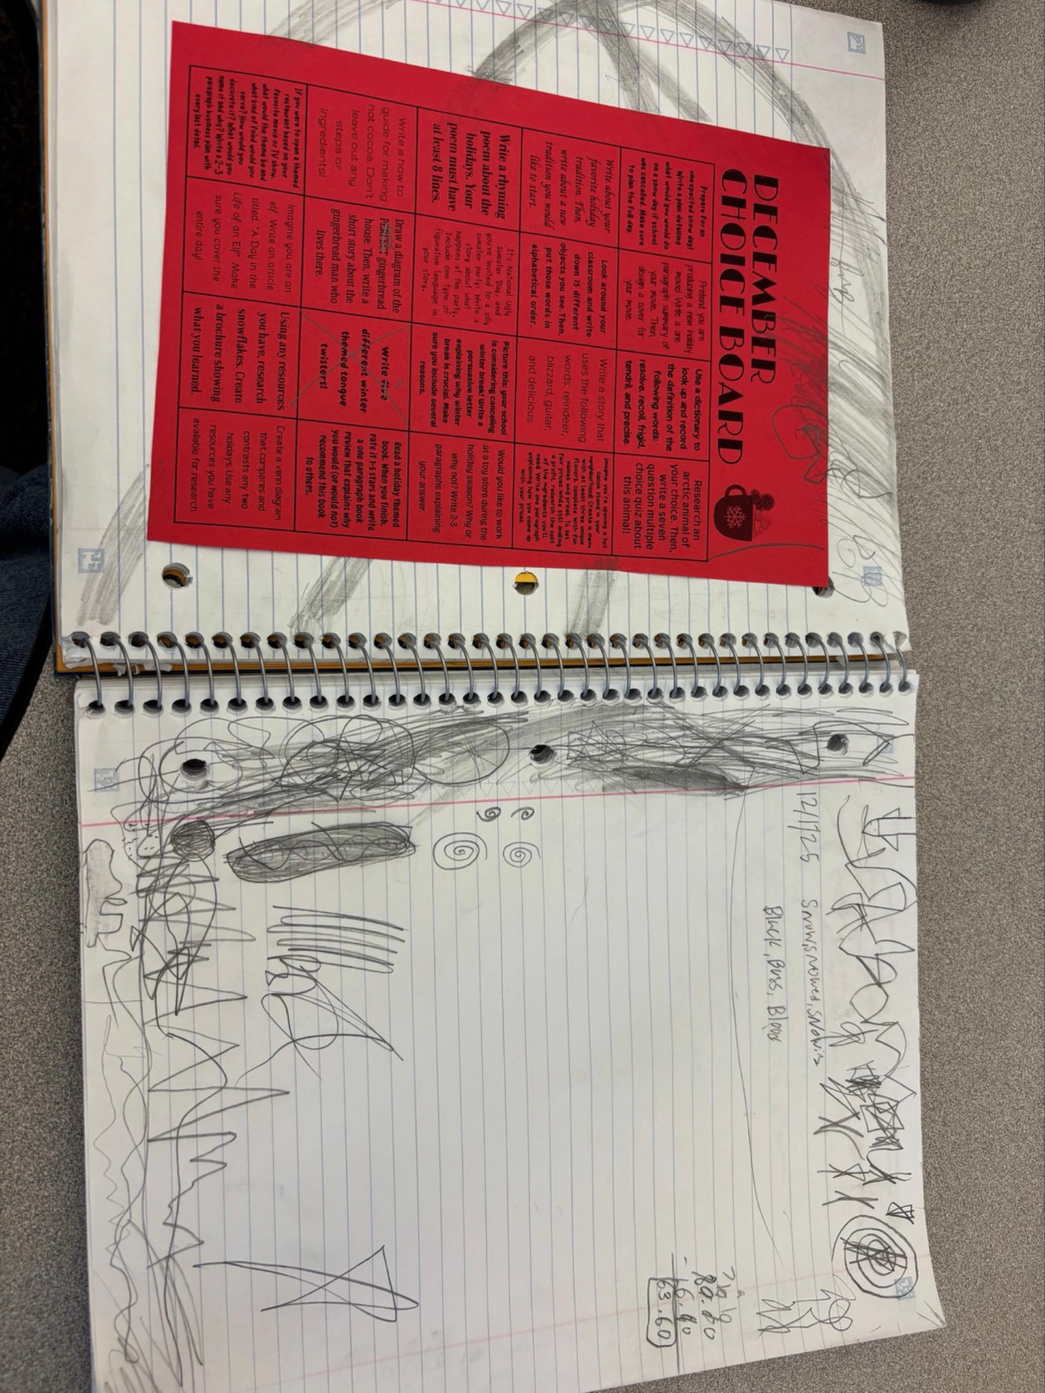
Notes:
Catherine

Slide 22
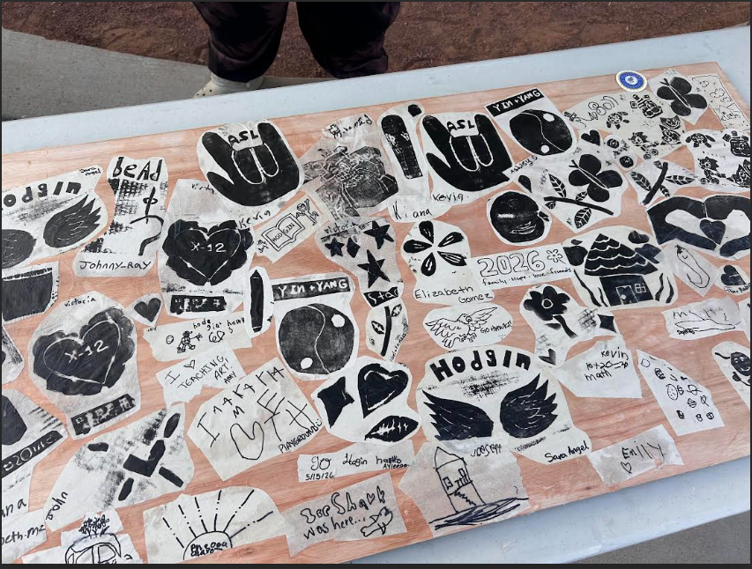
Notes:
Elizabeth

Slide 23
Different Roles Notice Different Things
Different roles notice different things in student testimony.
An educator may notice an instructional opening.
A coordinator may notice the relationships or supports behind an event or activity.
A principal may notice implications for school-wide culture.
A district leader might notice something that could be better aligned or sustained at scale.
Notes:
Lindsay

Slide 24
From Role-Based Noticing to Shared Leadership
The power in student testimony is not that we see the same thing.
The power is that we bring what we notice together.
When student testimony is viewed across roles, it becomes more than a moment of insight. It becomes a shared responsibility for instruction, support, leadership, and change.

Slide 25
Student Testimony Does Not Sustain Itself
Student testimony becomes curriculum only when adults build the structures, relationships, and habits to notice it, interpret it responsibly, and respond instructionally.
This is why Lead & Learn was designed as a professional learning model, not just an assignment or a project.

Slide 26
Activity:
If this is what we notice together, what must we hold together?
Notes:
Lindsay 4:30

Slide 27
Different Roles Notice Different Things
Role | Analysis Lens
Educators | What instructional decisions, rigor, or learning opportunities are visible?
Coordinators | What conditions, relationships, supports, or community context made this possible?
Principals | What schoolwide culture, priorities, or structures are involved?
District Leaders | What does this suggest about community school strategy coherence and professional learning needs of educators/schools?
Notes:
How feeder-pattern learning supports shared responsibility for student experience across grade levels
How districtwide learning builds common language and expectations for community-connected instruction
The specific leadership moves principals, coordinators, and district leaders make to protect instructional focus while supporting teacher well-being

Slide 28
Table Activity Instructions
At your table, you have a handout with questions. You will use the student artifact on the slide to answer those questions as a group.
Notes:
Student testimony becomes curriculum when adults across roles notice what students reveal and create the conditions for it to shape instruction.

Slide 29
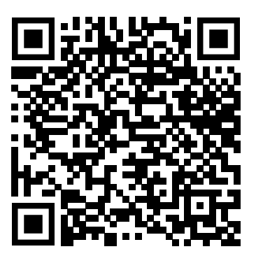
Table Activity Instructions
Three Frames:
What are students saying, doing, or showing?
  Stay grounded in student testimony. What is your interpretation of what you see?
What does your role help you notice?
  Different roles notice different possibilities, conditions, and implications.
What leadership moves are needed so this shapes instruction beyond this moment?
  Educators, coordinators, principals, district leaders, students, families, and partners all hold leadership responsibilities in helping student testimony shape instruction over time. Each role leads and sustains the community school strategy.
Notes:
Student testimony becomes curriculum when adults across roles notice what students reveal and create the conditions for it to shape instruction.

Slide 30
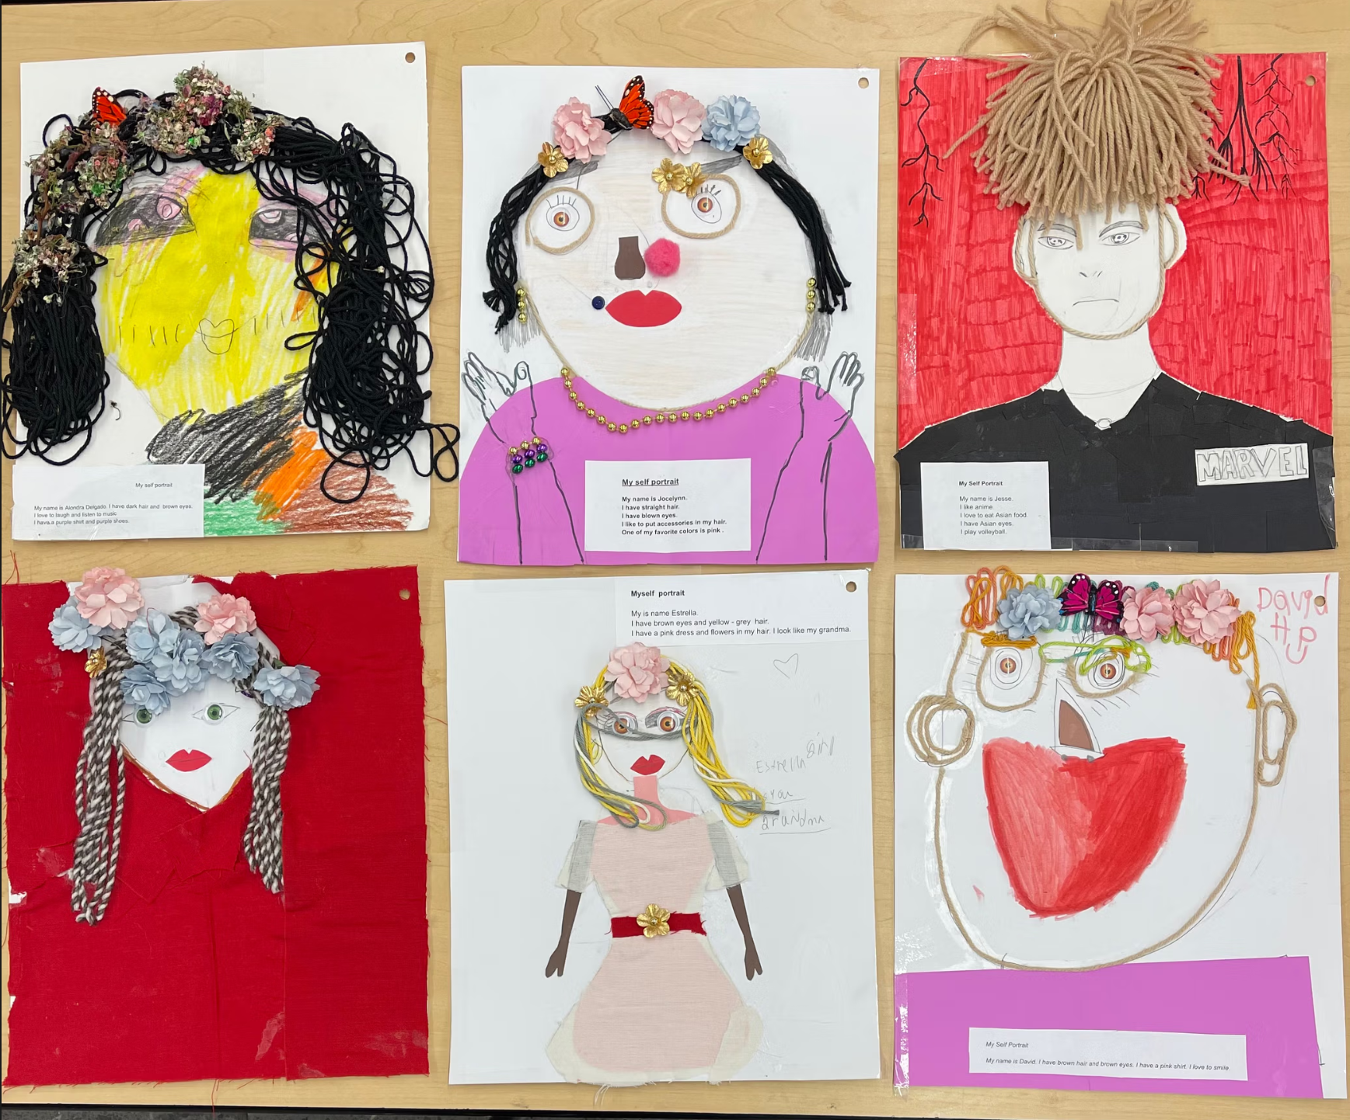
Notes:
Question: How can we use indigenous materials/materials available in the classroom to create a 'Living Story' that reflects our family’s heritage, identities, and learning?
Teacher: Lorena Lutter

Slide 31
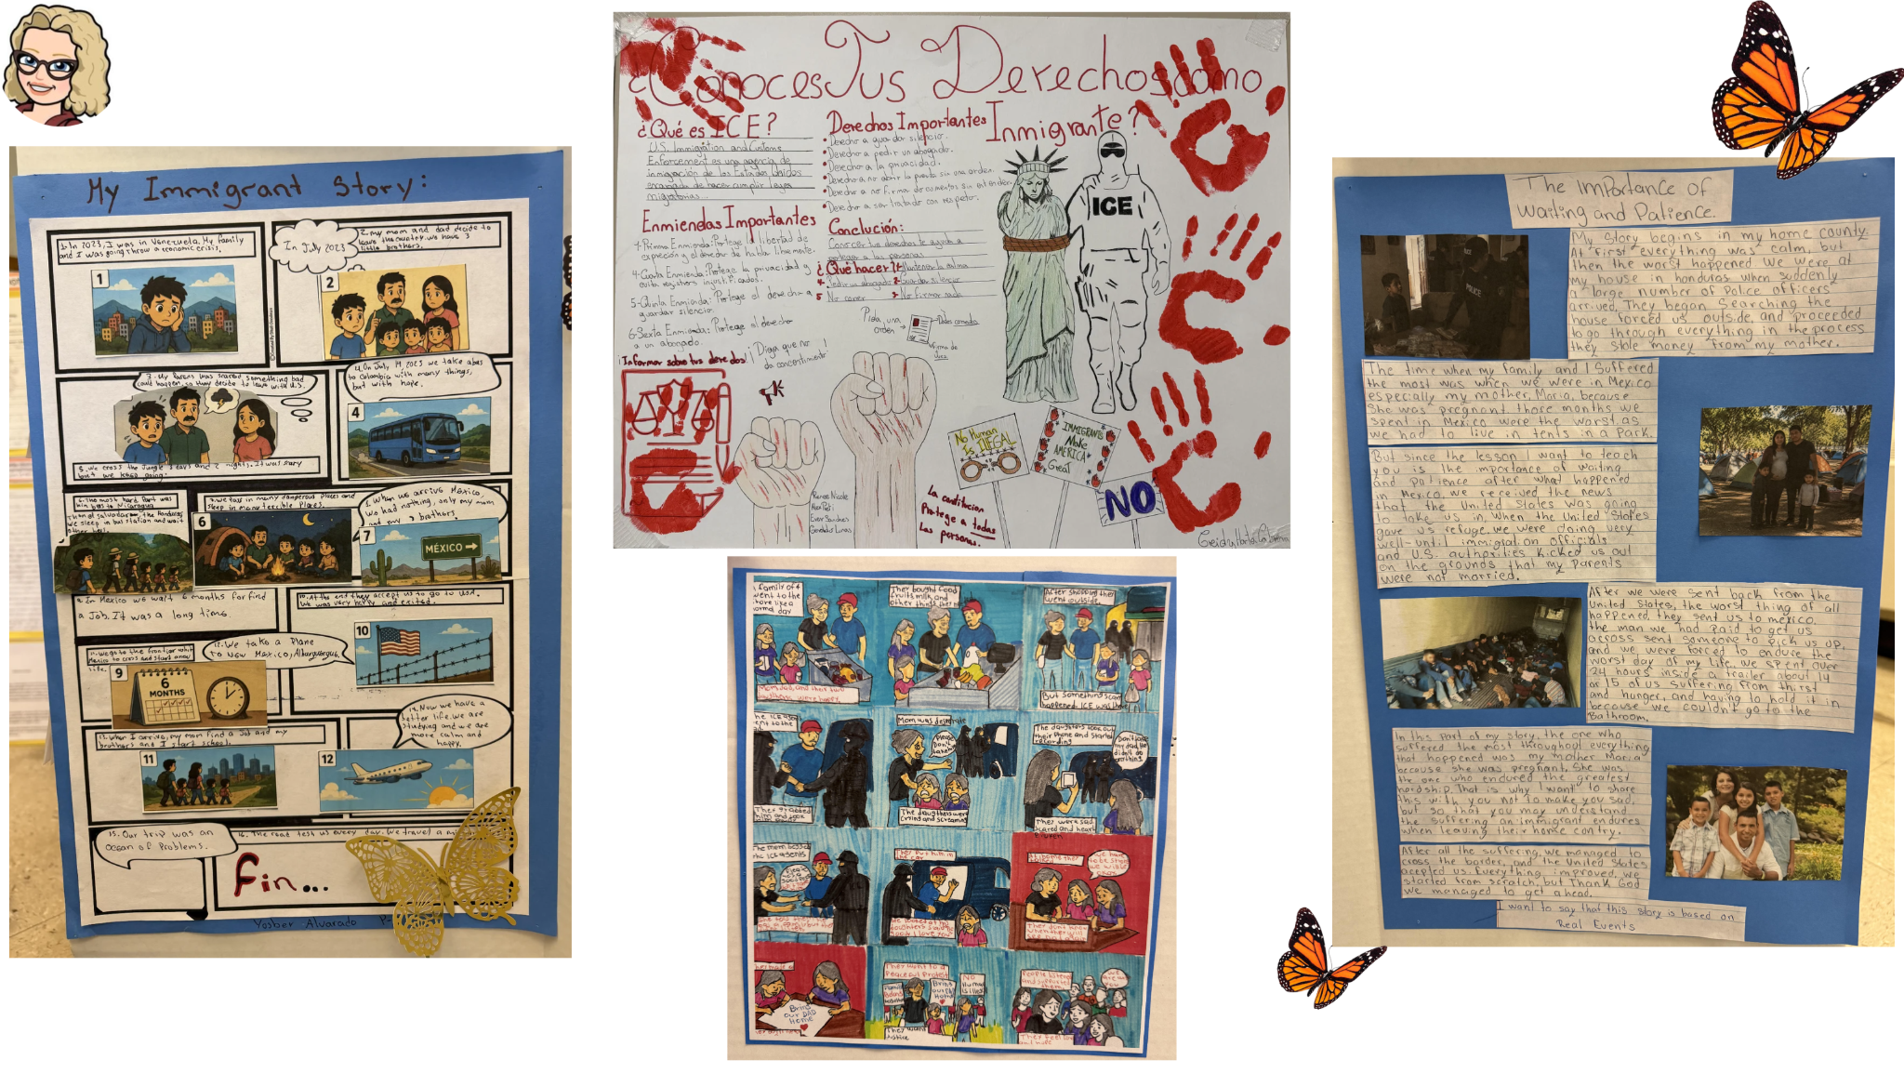
Notes:
How can we, as Highland High School students, use story elements and figurative language to protect our community from ICE by building empathy

Slide 32
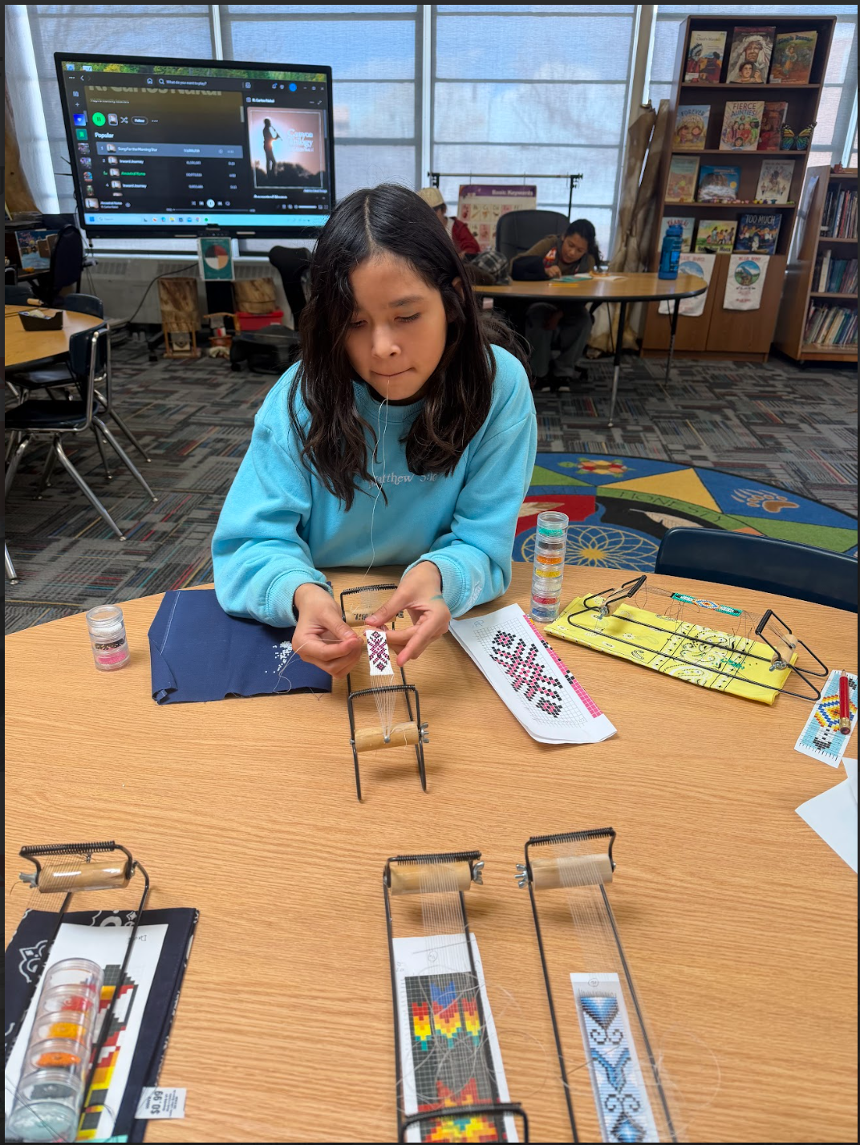

Slide 33
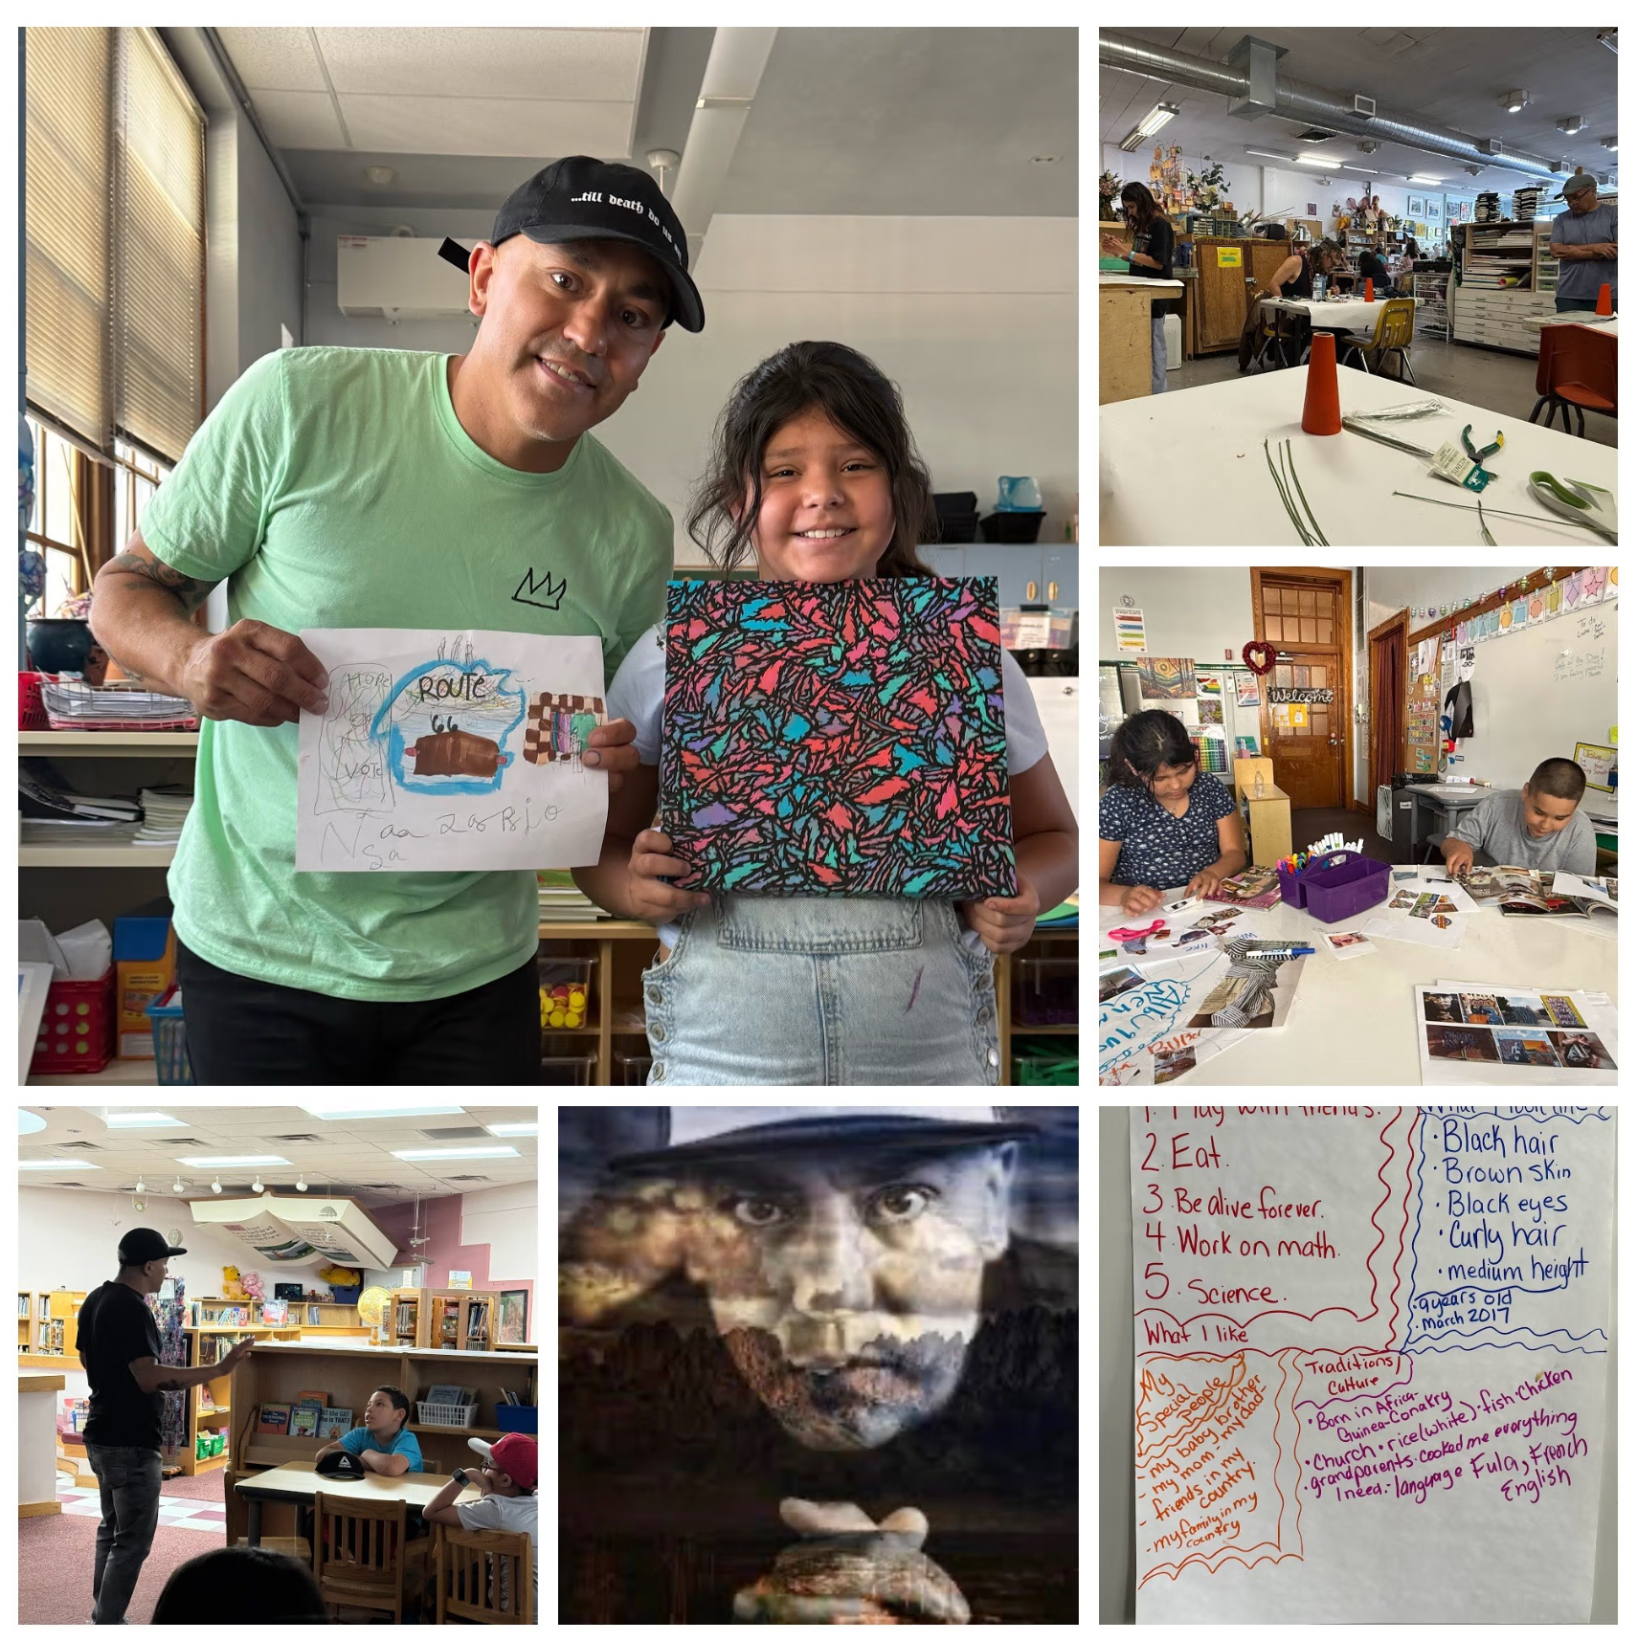
Notes:
Project Title: Expressing Identity & Belonging through Art
Teacher: Celina Quezada
Driving Question: How can we use art to express who we are and show how we belong in our community?

Slide 34
Table Activity Instructions
Role | What this role notices | Leadership move to sustain the work
Educator
Coordinators
Principals
District Leaders
Families/Community Partners
Notes:
Student testimony becomes curriculum when adults across roles notice what students reveal and create the conditions for it to shape instruction.

Slide 35
Whole Group Debrief
What did different roles notice about what students are saying, doing, or showing?
How could this testimony shape instruction or professional learning opportunities?
What leadership moves are needed to sustain this beyond one classroom or moment?
What does this tell us about the community school strategy?
  How does centering student testimony help us understand community schools as more than programs and services—and as a strategy that must shape instruction, relationships, and shared responsibility?
Notes:
4:45 Catherine

Slide 36
What We Learned
Notes:
4:50 start Catherine + all

Slide 37
What We Learned - Educators as Risk Takers
Across Lead & Learn, we learned that student-centered, community-connected instruction asks educators to take real instructional risks. Educators are asked to listen differently, share power with their students, respond to student and family experiences, and connect learning to community.
All of this requires educators to depart from familiar routines. And often these routines are what is expected (surveilled?) by principals or district leaders.

Slide 38
What We Learned - Instructional Shifts
This kind of instructional shift requires:
Trust among adults
AMPLE time to reflect and collaborate
Permission (from themselves especially) to learn and try something new
Support when engaging in this work inevitably raises complexity
Leadership that protects the work from becoming “one more thing”
Coordination that connects instruction to students’ rich, vast, fuller lives beyond the classroom, beyond the school building

Slide 39
What We Learned - Educator Well-Being
Lead & Learn also showed that educator well-being is not separate from instructional transformation. Educators are more able to take risks, collaborate, and respond to students when they feel connected, trusted, and supported.
Lead & Learn supported educator well-being through:
Meaningful collaboration across schools and roles
Opportunities to reflect on purpose and identity
Seeing student experience as central to the work
Having space to name tensions and uncertainty
Knowing the work is shared, not carried alone
Showcasing their work - this was big!

Slide 40
Lead & Learn Fellow Quote (2026)
I feel like I could now present myself as a community school educator, and explain to someone what it means to be one on a daily basis, and do this work as a school/community. It has also really changed how I feel about myself as a teacher and educator. This is the best I have felt.

Slide 41
What We Learned - The Role of the Coordinator
Instructional transformation depends on in-between work:
Connecting people who would not otherwise be in conversation
Translating between school priorities and educator realities
Making student and family patterns visible
Aligning professional learning with the community school strategy
Protecting instructional focus amid competing demands
Keeping relationships and trust at the center

Slide 42
What We Learned - This Cannot Depend on One Excellent Teacher
Rigorous, community-connected learning and instruction is powerful, but it becomes fragile when it depends only on individual teacher passion or isolated innovation.
Across Lead & Learn, we saw that sustainability requires:
Educators designing RCCCI
Coordinators connecting conditions, relationships, and supports
Principals protecting school-wide culture in support of RCCLI
District leaders aligning professional learning and resources
Students shaping the direction of learning
Families and community partners deepening relevance and context for RCCLI

Slide 43
What We Learned - Overall
Student testimony is not an add-on; it can be a source for curriculum.
Community-connected instruction requires both rigor and responsiveness.
Teacher well-being matters because instructional risk requires support.
Coordinators, principals, and district leaders shape the conditions around instruction.
Feeder-pattern and districtwide learning structures help move this work beyond isolated classrooms.

Slide 44
What We Learned - Overall
Community school transformation happens when systems become visible to students through everyday instruction.

Slide 45
Thank you!

Slide 46
Junk yard

Slide 47
Part 3:
What Leadership Makes Possible

Slide 48
Shared Responsibility Across Roles
Instructional transformation is not the burden of one (or two!) excellent teacher.
Role | What this role makes possible (connect to different roles see different things)
Teachers | Responsive, rigorous, student-centered, community-connected instruction
Coordinators | Conditions, relationships, connections, and supports
Principals | School culture, coherence, protection, and priorities
District Leaders | Structures, policy alignment, resources, and scale
Families/Community Partners | Context, expertise, relationships, relevance, accountability
Students | Testimony, agency, questions, direction

Slide 49
Table Activity
Creating more authentic family/community connections in support of rigorous classroom instruction
Notes:
Consider how this more directly links to what

Slide 50
Whole Group Debrief
If we have time?

