Slide 1










LIGHTING THE PATH FOR COLLABORATIVE MEETINGS
Conversations that connect people, purpose, and outcomes
ABC Community School Partnership
Silvina Tello
Albuquerque Public Schools
G.Bryan Garcia

Slide 2



QUICK SHOW OF HANDS
What role do you play in your CS initiative?
District Leaders
Principals
Others
CS Coordinators or Directors
Technical Assistance Centers
Lead Partner Agencies

Slide 3

Learn how Results Based Facilitation skills can be used to deepen collaborative leadership, shared power and voice in community schools
Hear from community school practitioners’ experiences facilitating collaborative meetings
RESULTS
Leave with ideas and resources to support them in designing and facilitating meetings that drive impact
By the end of meeting, participants will:

Slide 4
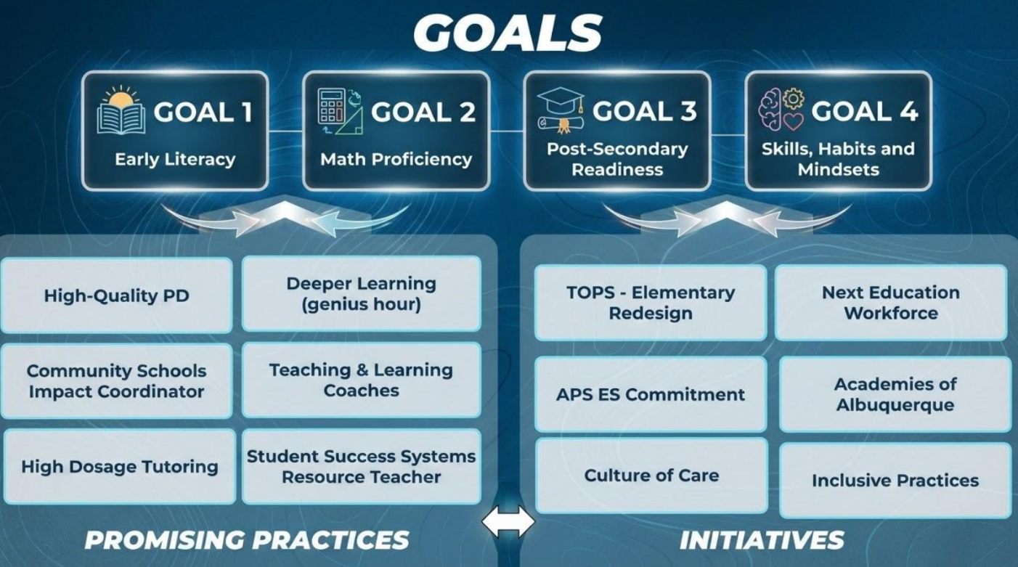

Slide 5


Slide 6
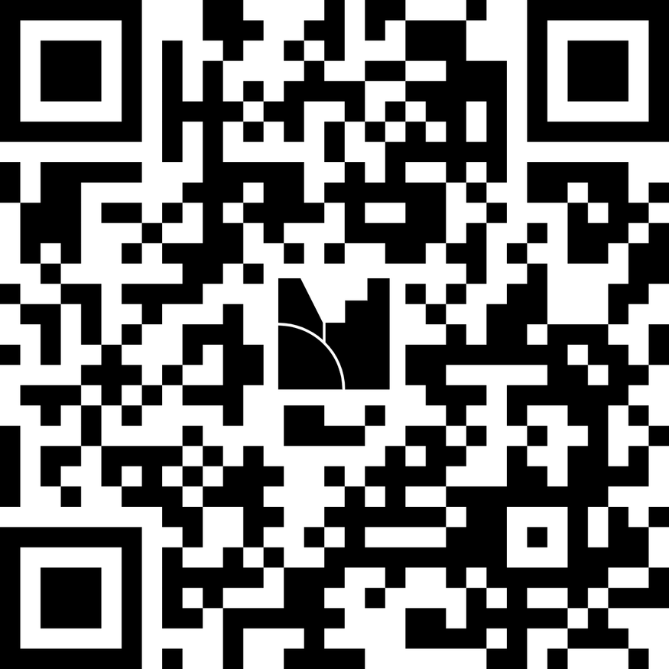

REVERSE BRAINSTORM
At your table:
Think of a meeting you’ve been to that didn’t feel very collaborative. What made it feel that way?
menti.com
64747058

Slide 7
RESULTS-BASED FACILITATION
Why RBF?
RBF is a Results-Based Accountability framework that helps us understand if we are moving towards results and having the right conversations.
Hold Roles
Hold Groups
Hold Mental Models
Hold Action & Results
Hold Conversations
Hold 3R Meetings
Hold Mental Models

Slide 8
MEETING RESULTS
Why prepare meeting results?
Meeting results provide a level of clarity necessary to turn a conversation into decisions and next steps.
What do you want to be different after the meeting?
What is the priority?
What is possible?
What does this group want to accomplish?

Slide 9
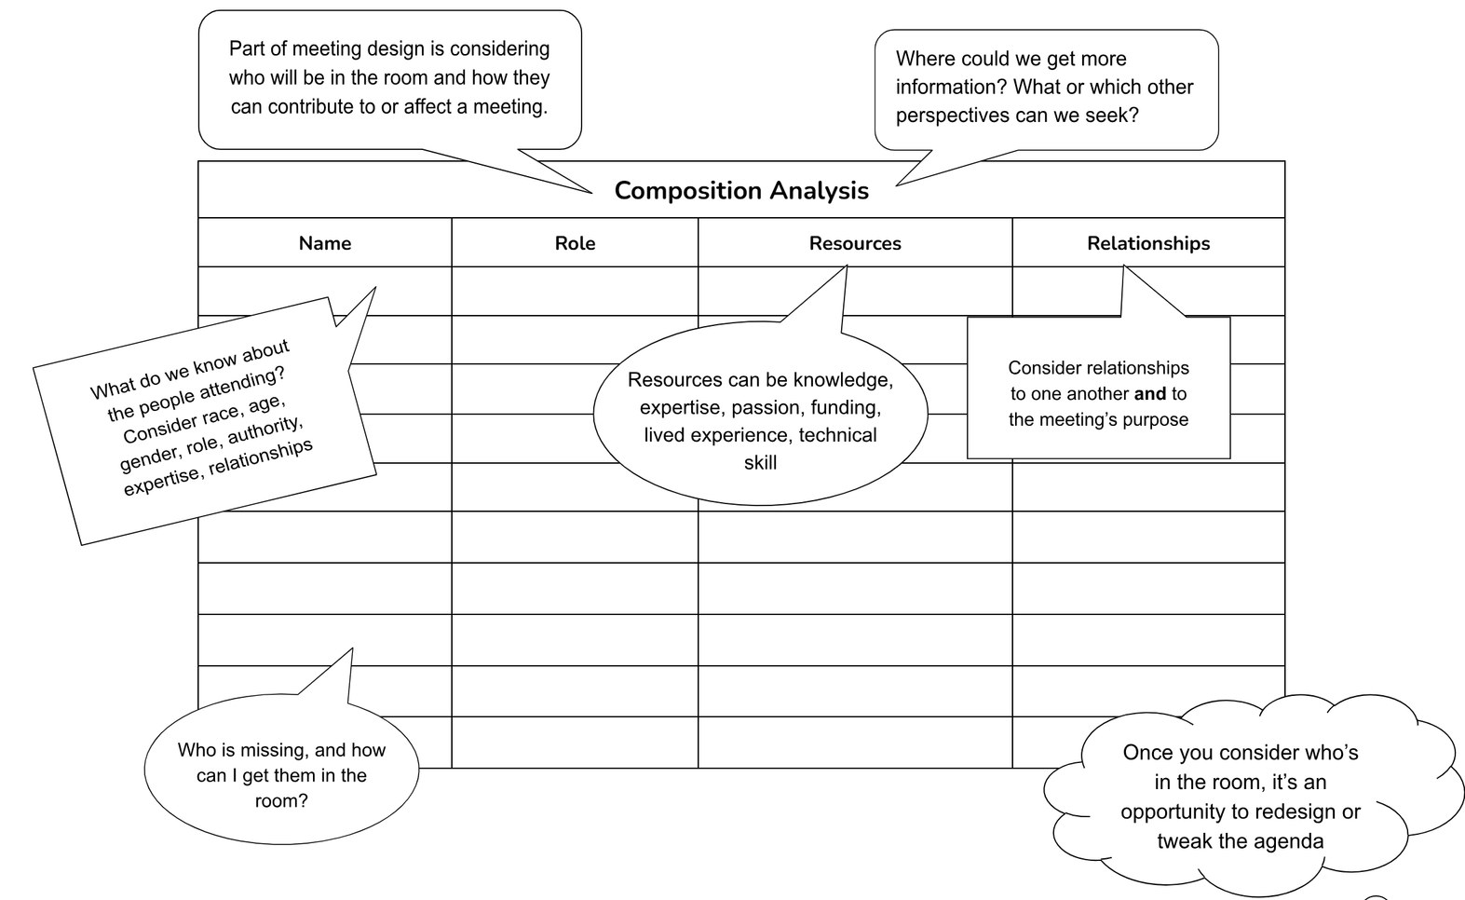

RESULTS-BASED FACILITATION
Hold 3R Meetings
Relationships + Resources = Results

Slide 10




COORDINATOR PANEL
Jessica Ward
Community School
Impact Coordinator
Halecia Wimpy
Community School
Impact Coordinator
Alondra Dominguez
Community School
Impact Coordinator
Rios Fernandez
Community School
Impact Coordinator

Slide 11
Question 1
What result or change were you trying to achieve through your CS Council?

Slide 12
Question 2
In what ways did the CS Council help build relationships and connect resources that supported movement toward your identified result?

Slide 13
Question 3
What results or early outcomes have you seen?

Slide 14
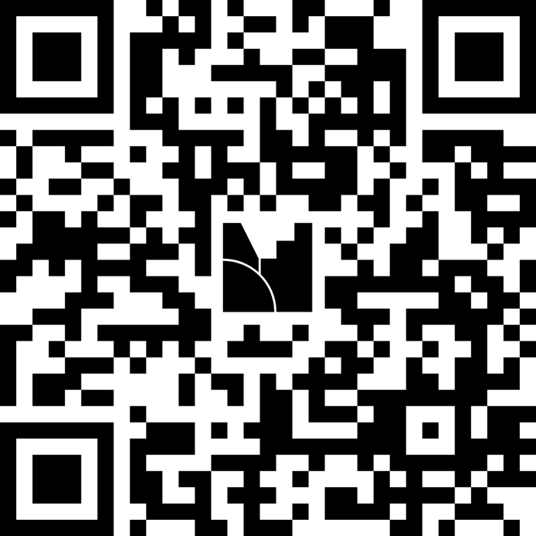
SESSION EVALUATION
Let us know how we did!
Go to
www.menti.com
and enter the code
5171 5894
Or scan QR code

Slide 15
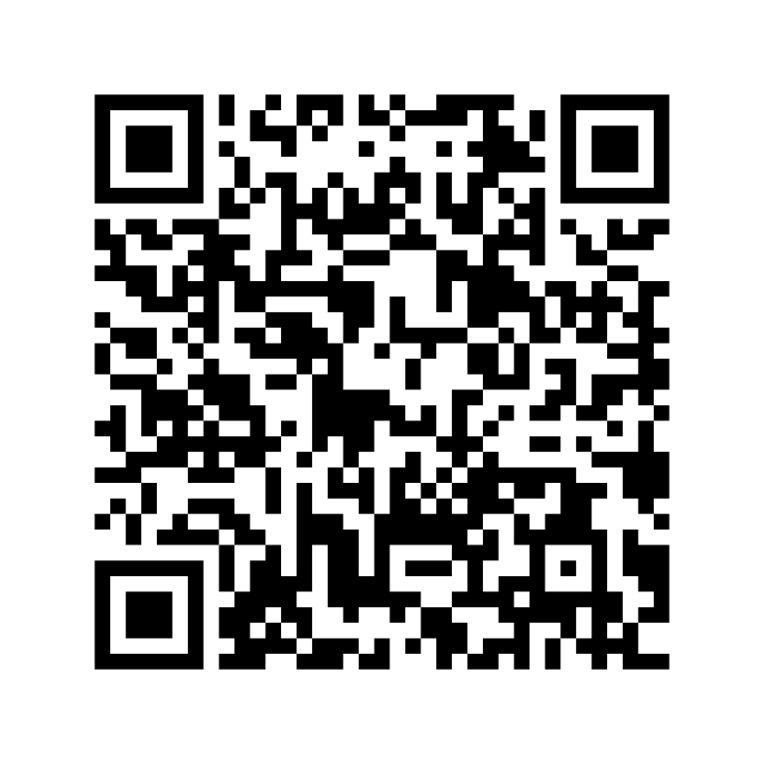
SESSION RESOURCES
Thank You!

