Slide 1



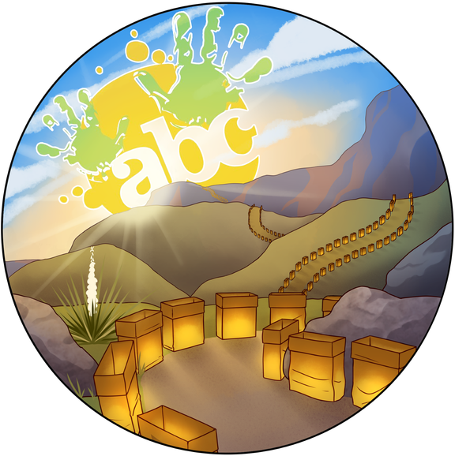
Setting the Table for Powerful Family Engagement with Homework Diner!
5/27/26
3:00 PM - 4:15 PM
Deanna Creighton
ABC Community School Partnership
Albuquerque, NM

Slide 2
Results
By the end of this session, participants will:
  Understand the origin and evolution of the Homework Diner program
  Recognize family engagement as a community-building and belonging strategy
  Identify barriers and assets within their own communities
  Explore cross-sector partnership and sustainability strategies
  Develop concrete ideas for action
  Frame success and outcomes in family engagement work

Slide 3
Choose 1 or 2 of these questions and share with your table....
Why am I called to this work?
What values move me to act?
What stories can I tell from my own life about specific people or events that would show, rather than tell, how I learned or acted on those values?
Why did I decide to tackle [a specific injustice or problem]?

Slide 4
Challenges and Frustrations
1. What were students and families experiencing?
2. What were teachers experiencing?
3. How could the community school strategy help?

Slide 5
Challenges and Frustrations
1. What were students and families experiencing?
2. What were teachers experiencing?
3. How could the community school strategy help?
Share Any Similar Challenges
and Frustrations

Slide 6
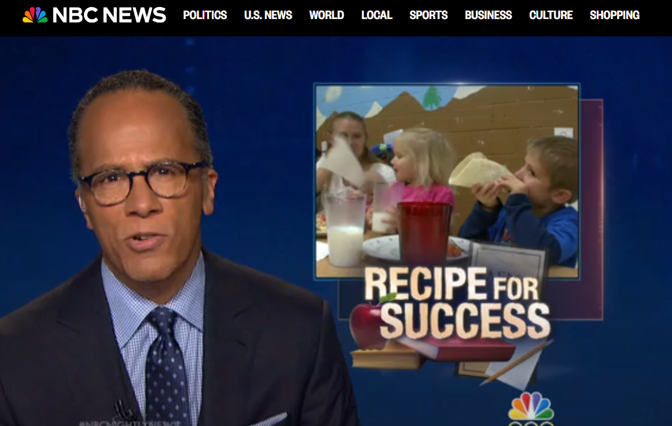
What We Decided to Do

Slide 7
What Stood Out to You?

Slide 8
Building Homework Diner as a CS
  Took the idea to our community school council
  Started with a 5-week pilot
    Surveyed parents, students, and teachers
  Identified variety of funding streams
    micro-grant
    donations
    Albertson’s
  Developed partnerships for sustainability
    CNM Culinary Arts Program
    City of Albuquerque
    Keeler Foundation

Slide 9
Setting Your Table

Slide 10
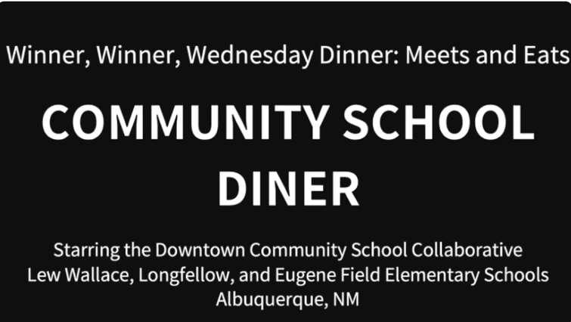
Setting Your Table
  What challenges exist in your community?
  What barriers to family engagement are you seeing?
  What strengths and assets already exist?
  Who needs to be at the table?
  What funding or partnership opportunities could support this work?

Slide 11
Group Share-Outs
  One challenge
  One promising strategy
  One idea you want to explore further

Slide 12
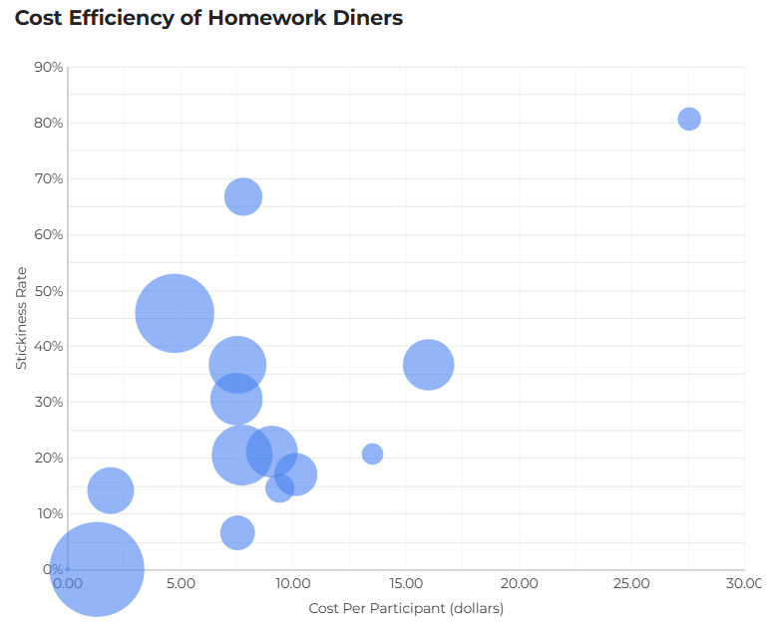
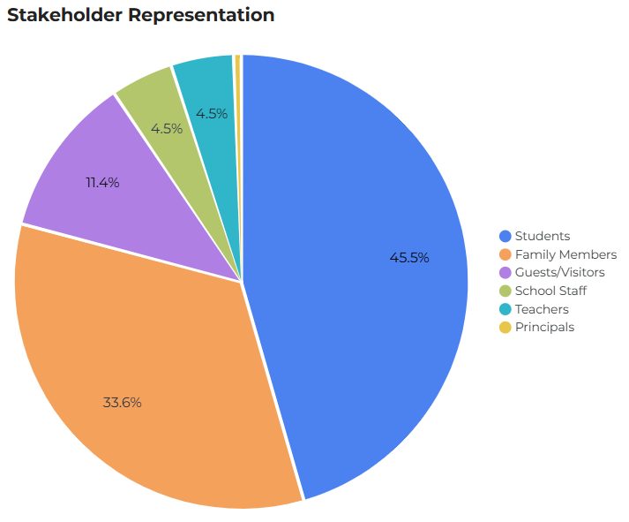
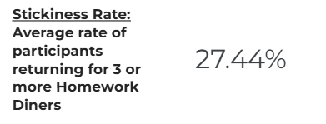
Impact - the Homework Diner Dashboard
  Video featuring families and community
Link to view dashboard

Slide 13
Action Planning
  One outcome you would like to see
  One next step you can take
  One partner you need to engage

Slide 14
Closing Reflection
“What does it mean to truly set the table for families in your community?”

Slide 15
Resources
  Homework Diner Dashboard
  Cities of Service Homework Diner Blueprint
  Homework Diners in North Carolina - Asheville & Buncombe County

Slide 16
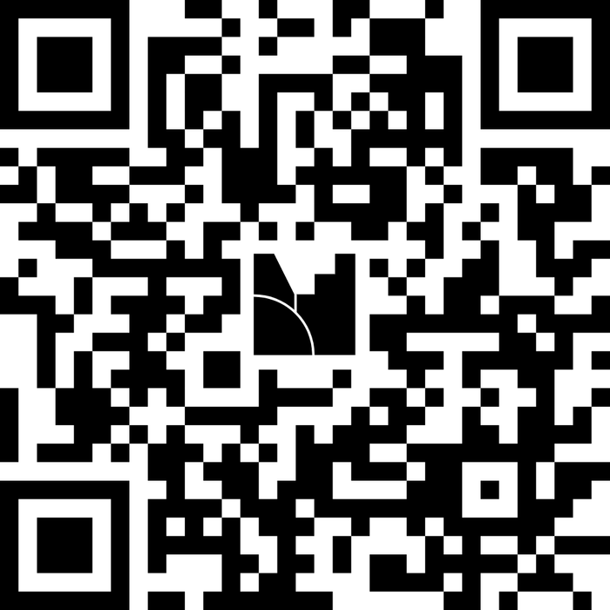
Session Evaluation
Let us know how we did!
Go to
www.menti.com
and enter the code
8951 2153
Or scan QR code

